Slide 1
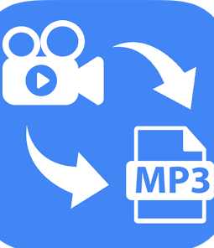
VIDEO TO AUDIO CONVERTOR
PRESENTER : GUIDE:
HANEESH-2010030323 P.SREELAKSHMI LAHARI -2010030372
MOUNIKA -2010030384
RITHVIK -2010030421

Slide 2
Converting videos to audio files is the one of the best way to listen the desirable audio without having to watch the video.It is most often used to record the soundtrack of videos or to extract other audio tracks from videos where you are only interested in the sound.As, the size of the audio file is much smaller than that of a video file. If you like that video file but your device is running out of space, and thus you cannot download and store it in the device, you can easily convert it to audio format and store easily.
ABSTRACT

Slide 3
INTRODUCTION:
Converting video to audio files is very essential step when you are passionate music mixer or you like to create videos using different sound effects . It will be easy Gather Sound Effects to do Remixes, special versions or covers of popular songs with desirable audio files then from video files. You can store the audio of your favourite video which may not be found from other sources. It also helps to save space, improves Sound quality, Extract Famous Movie Quotes

Slide 4
LITERATURE REVIEW:
This tool helps in converting the video files present in computer or youtube to mp3 audio files. It comes with a very simple user interface. You will want to grab the URL and it should be pasted into the stipulated textbox on the website. As you click on the ‘convert to mp3’ button, you will obtain the lightweight audio file in few seconds. You can download the audio file by clicking on the ‘download’ button. Most of the converters have used Python libraries like FFmpeg and MoviePy for the conversion of Video to Audio

Slide 5
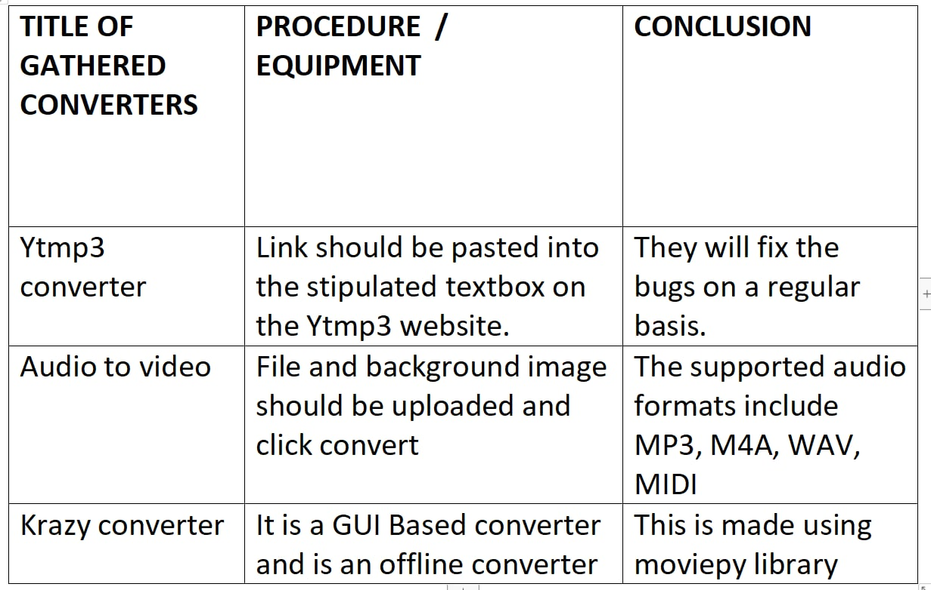
METHODS USED:

Slide 6
RESULTS:
There are many tools available online, those help users convert video to audio files. Some of the tools take video URLs as video input files while others take video files directly. Some of the video editing software can also do this work easily. Some of the converters can be guaranteed of the best quality sound after converting. During the research, most of the converters used FFmpeg and MoviePy libraries in their code.
So, we want to develop a similar kind of application with simple GUI using python language.

Slide 7
CONCLUSION:
This convertor is most useful for heavy listeners of music as they prefer keeping audio files on their phone than video files to consume less disk space. The content posted on youtube will not last forever. If any videos violate the piracy norms, they will be pulled down. Hence, you will not be able to access those videos. Using the video to audio converter tool, you can convert the video file into an audio file very quickly and it is possible to make the most of your time, effort, and money.

Slide 8
Thank you!

